Slide 1
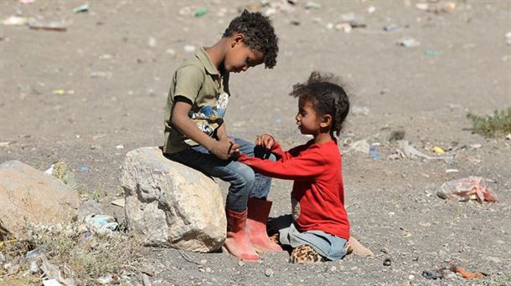
VULNERABILITY “ON ANOTHER SCALE” Structural sin
Ernesto Cavassa sj
Belén Romá

Slide 2
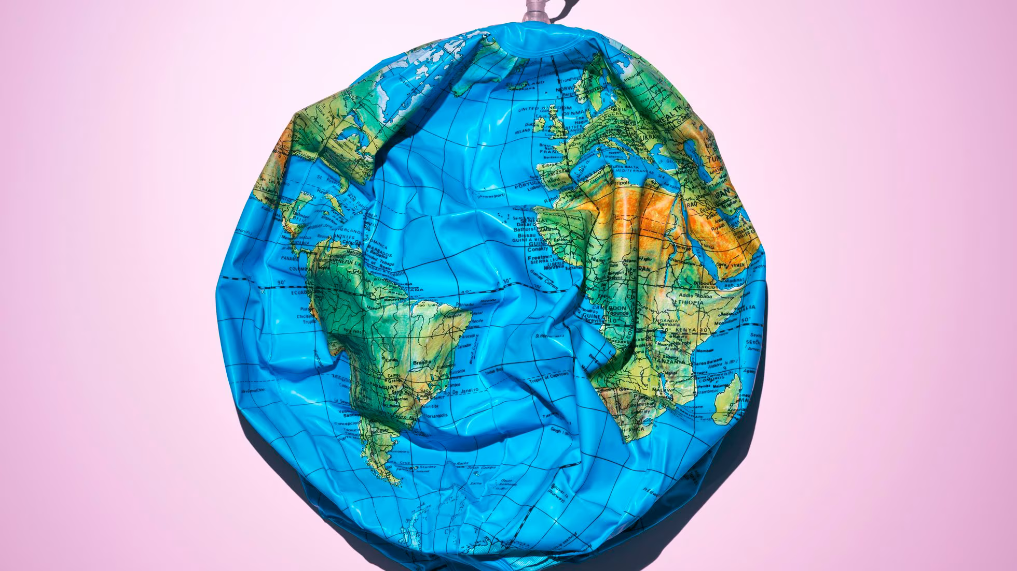
ANTIGENESIS Myth of uncreation (JI Gonzalez Faus)

Slide 3
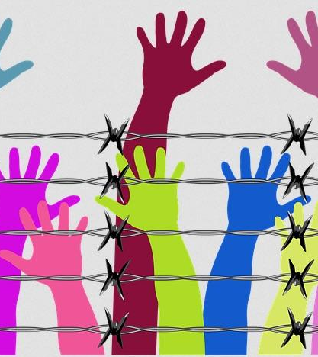
RUPTURES HAVE A NAME: SIN
“According to the Bible, the three vital relationships (with God, with our neighbor, with the earth) have been broken, not only externally but also within us. This rupture is sin …today sin is manifested with all its destructive force in wars, the various forms of violence and mistreatment, the abandonment of the most fragile, attacks on nature”
(Laudato Si, no. 66).

Slide 4
“STRUCTURES OF SIN”
John Paul II : "It is not possible to easily reach a deep understanding of the reality that we have before our eyes without giving a name to the root of the evils that afflict us... The real nature of the evil that we face in the question of development of the peoples is a moral evil, the fruit of many sins that lead to structures of sin .
Francisco : “the way in which humanity has in fact assumed technology and its development together with a homogeneous and one-dimensional paradigm…the technocratic paradigm . It supposes the lie of the infinite availability of the planet's goods that leads to 'squeezing' it to the limit and beyond the limit” (Laudato Si, 106). "There are not two separate crises, one environmental and the other social, but a single and complex socio-environmental crisis" (LS 139).

Slide 5
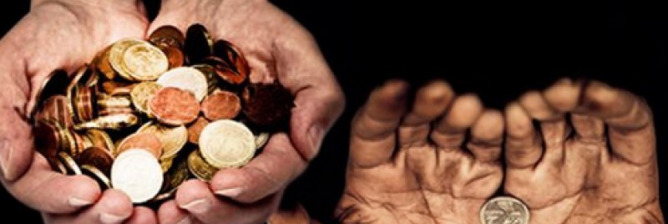
THE RICH DIVES AND THE MILLIONS OF LAZAROS
“These are almost official data: the 50 richest people in the world have a net worth equivalent to 2.2 trillion dollars. Those fifty people alone could fund the healthcare and education of every poor child in the world, whether through taxes, philanthropic initiatives, or both. Those fifty people could save millions of lives every year.”
(Pope Francis, Address at the New Forms of Solidarity Seminar, 02/05/20)

Slide 6
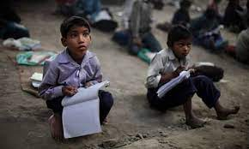
WORLD INEQUALITY
Comprehensive, quality education and graduation patterns remain a global challenge. Despite the objectives and goals formulated by the United Nations (UN) and other organizations (cf. Objective 4), and the important efforts made by some countries, education continues to be unequal among the world population.
(Speech at the Education Seminar: The Global Compact, 02/07/20)

Slide 7
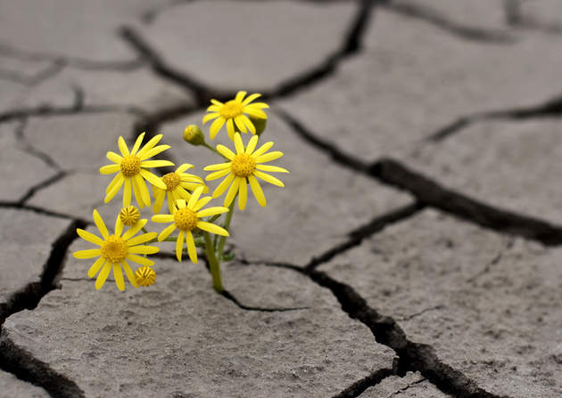
IT IS POSSIBLE TO CHANGE THE LOGIC
Another fundamental principle that must be put back at the center of the educational agenda is the one by which it is affirmed that the world can change . Without this principle, human desire, especially that of the youngest, is deprived of the hope and energy necessary to transcend, to go towards the other.
(Instrumentum laboris, The Vision. 3. The world can change)

Slide 8
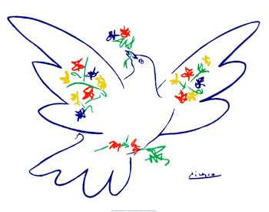
CALLED TO BE BUILDERS OF PEACE
Brothers, sisters, we are called to be missionaries of peace , and this will give us peace. It's a choice; is to make room in our hearts for everyone, is to believe that ethnic, regional, social, religious and cultural they come later and are not obstacles; that the others are brothers and sisters, members of the same human community; that each one is the recipient of the peace that Jesus has brought to the world. It is believing that Christians are called to collaborate with everyone, to break the cycle of violence, to dismantle the plots of hate. Yes, Christians, sent by Christ, are called, by definition, to be aware of peace in the world ; not only critical consciences, but above all witnesses of love ; not claiming their own rights, but those of the Gospel, which are brotherhood, love and forgiveness; not seekers of their own interests, but missionaries of the passionate love that God has for every human being
Moto azalí na matói ma koyoka [He who has ears to hear] R/Ayoka [Let him hear]
Moto azali na motema mwa kondima [He who has the heart to accept] R/Andima [That I accept]
Pope Francis, Apostolic Visit to the Democratic Republic of the Congo, Kinshasa, 02/1/23

Slide 9
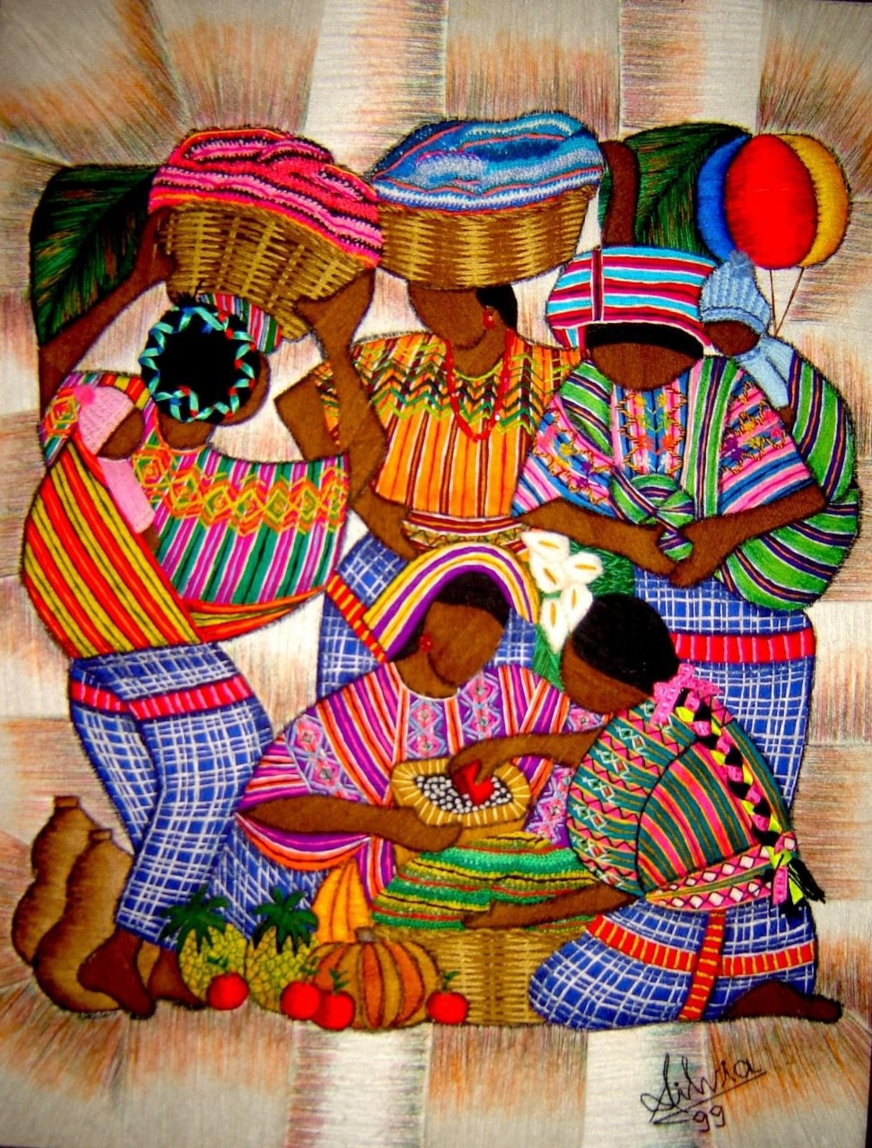
MYSTIC EDUCATORS
And in this perspective we feel the challenge of discovering and transmitting the 'mystique' of living together , of mixing, of meeting, of holding arms, of supporting each other, of participating in that somewhat chaotic tide that can become a true experience of fraternity. , in a solidarity caravan (EG 87).
(Instrumentum laboris, 1. Introduction)

